Slide 1

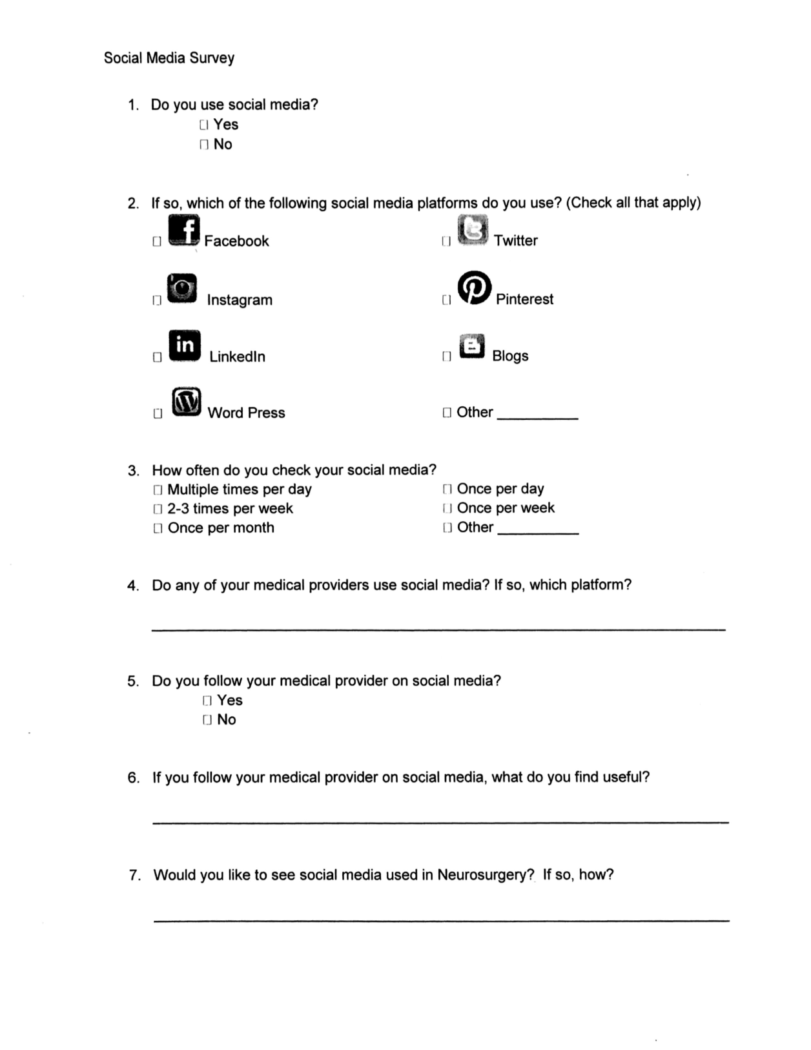
Social Media Use in Neurosurgery
Ashley Shatola, Dr. Li-Mei Lin
UC Davis School of Medicine, UC Irvine School of Medicine
INTRODUCTION
MATERIALS AND METHODS
RESULTS
CONCLUSIONS
Social Media use is expanding across the country, from business to clinical practice. Many physicians have begun to incorporate social media into their practice. This project explores patient interest with social media use in Neurosurgery.
Previous studies have examined the types of social media used by Neurological surgeons. This study could help understand potential patient and visitor interest.
We suspect that some patients and visitors already use social media in their daily lives. We hypothesize some may be interested in seeing social media used by neurosurgeons.
Social media provides a broad array of information to patients from content about diagnosis, procedural practice, alternative medicine, and patient testimonials. We believe that our study population may have ideas about what type of information they would like to have available to them through social media.
Patients and visitors to the University of California Irvine Neurological Surgery Clinic were asked if they would be willing to complete an IRB approved survey on the use of social media in Neurosurgery. Seventy patients and visitors were given the survey and asked about their social media use, and if they would like to see social media used in Neurosurgery. They were also given the opportunity to elaborate on what information would be helpful for them on social media.
The anonymous survey was seven questions, given at random to both patients and visitors. The maximum expected survey time was five minutes. The survey was made available to anyone eighteen years of age or older, and no identifying information was collected from participants. No patient history, or records were used and there were a total of 51 surveys collected from the 70 asked to participate. Potential subjects were approached by the research team and asked whether they would be willing to complete a five minute social media questionnaire.
The survey asked participants whether or not they used social media platforms and if so, what social media platforms they used. They were then asked how often they use those social media platforms, if they currently follow their medical providers on social media, and if they felt having a neurosurgeon use social media would be helpful. Patients were asked to mark which of seven social media sites they used with an option to add in an alternative.
The project received approval by the University of California Irvine IRB. UCI IRB Approval Obtained: 11496
The study found that 70.58% of participants used social media. Of those 61.11% reported using social media multiple times per day. Those that used social media multiple times per day most often used Facebook (94.44%) and Instagram (41.67%).
Table 1
Table 1 This table reports the frequency of social media platform use among participants who used social media.
Image 1.1
Image 1.1 Shows the reported daily use of social media platforms among participants.
The sample size of this study was relatively small making it difficult to determine the studies broader significance. Participants surveyed were limited to those visiting the Neurological Surgery clinic and we may have missed some populations who access Neurological Surgery information or resources elsewhere.
.
Many patients and visitors of the University of California Irvine Neurological Surgery clinic currently use varying social media platforms in their daily lives. Patients and visitors utilize social media at different frequencies. There is potential interest in seeing neurosurgery used in social media, but a larger population should be surveyed to evaluate greater interest. In our small sample size there was a greater interest in social media use in neurosurgery among people that used social media most frequently. When asked what participants might like to see a majority were unsure, but some expressed interest in resources about specific medical conditions, success stories and a potential network of survivors with their condition. Further studies could identify patient and visitor interest in seeing neurosurgery in social media and better determine which resources they would find most useful.
Based on these findings there may be interest in the use of social media and neurosurgery especially among those that use social media multiple times a day. It is uncertain what type of material people will find the most beneficial on social media.
Social Media Platforms Used | Number of Participants Reported Using
Blogs | 2
Facebook | 34
Instagram | 15
Linkden | 5
Pinterest | 10
Tumblr | 1
Twitter | 7
Word press | 0
HYPOTHESIS
REFERENCES
Alotaibi NM, Badhiwala JH, Nassiri F, Guha D, Ibrahim GM, Shamji MF, et al.: The current use of social media in neurosurgery. World Neurosurg 88:619–624, 624.e1–624.e7, 2016
Alotaibi NM, Samuel N, Wang J, Ahuja CS, Guha D, Ibrahim GM, et al.: The use of social media communications in brain aneurysms and subarachnoid hemorrhage: a mixed-method analysis. World Neurosurg 98:456–462, 2017
Patel R, Chang T, Greysen SR, Chopra V: Social media use in chronic disease: a systematic review and novel taxonomy. Am J Med 128:1335–1350, 2015
Vardanian, A. J., Kusnezov, N., Im, D. D., Lee, J. C., & Jarrahy, R. (2013). Social Media Use and Impact on Plastic Surgery Practice. Plastic and Reconstructive Surgery, 131(5), 1184-1193. doi:10.1097/prs.0b013e318287a072
Gould, D. J., & Nazarian, S. (2017). Social Media Return on Investment: How Much is it Worth to My Practice? Aesthetic Surgery Journal. doi:10.1093/asj/sjx152
OBJECTIVES
Does Social Media have a place in medicine, specifically neurosurgery? The internet has improved access to information. Medical practice has expanded to using more digital methods of communication. Patients can now connect with their physicians via patient portals, access laboratory information online, and schedule appointments all within a few clicks. This availability has also led to further questions on how medicine can adapt to the changing media environment. Previous studies have suggested that there may be a way social media could benefit physician practice, patient experience and patient education. In this project we accessed patient and visitor interest in physician social media use, specifically in neurosurgery.
More commonly social media has been seen in Plastic Surgery, general practice through Dr. Oz, or international service physicians. But, more commonly many different specialists have began to increase their use of social media.
Limitations
ACKNOWLDEGMENTS AND CONTACT
Many thanks to the University of California Irvine Neurological Surgery Clinic, Dr. Li-Mei Lin, Dr. Shuichi Suzuki, and Dr. Sumeet Vadera for their assistance during planning, and data collecting procedures of this study.

